Slide 1
Microservices
And domain-driven design (DDD)
Ralph.squillace@Microsoft.com

Slide 2
The short version
What a microservice architecture is
Why now
What you need to know

Slide 3
My version of 12factor.net:
All stuff in origin/master, or it goes there.
Microservice code and config completely autonomous.
All non-domain resources are autonomous addressable resources.
Building, releasing, and running are autonomous.
Microservice goal: one stateless process.
Caveat: when point of service is to do multiprocess or stateful work (dbs).
If service is hosted in other framework, microservice treats framework as part of microservice as a unit.
Don’t block. Ever.
Throw problems away and start a fresh un-problem.
Test in production.
Logs are live test streams; see previous.
Admin processes: rarely, but against live code. See previous^2.

Slide 4
My version of Martin Fowler: “While there is no precise definition of this architectural style, there are certain common characteristics around organization around business capability, automated deployment, intelligence in the endpoints, and decentralized control of languages and data.” -- http://martinfowler.com/articles/microservices.html
Components are called “services”
Services based on business capabilities or processes, not skills.
Services are never finished, even when shipping.
Simplest communication possible (REST/oauth2); service logic can be complex.
Note: this is NOT the SOA approach!
Destroy implementation code/library standards. Only service façade and behavior matters.
Data just more microservices.
Automate EVERYTHING.
Failure is a normal part of entropy.
Chaos Monkey, the Simian army, and the Circuit Breaker pattern.
Evolutionary design – see point three, above.

Slide 5
Let’s break out the similarities:
Services are focused, entirely self-sustaining, largely single processes.
Everything external to the domain context of the service is a REST call (98% case) to another service for that domain.
Never tell the team how to build the service from the point of view of another service.
Failing services are destroyed and replaced as fast as possible. Period.
At scale, monitoring, logging, and testing are identical.

Slide 6
Thing to grok: Microservices are autonomous single processes
What does this even mean?

Slide 7
Thing to grok: Microservices are autonomous single processes
What does this even mean?
Means everything necessary to do that thing are in the service, and no more.
All the code
All the configuration
Nothing, not one thing, more
Architectural issue:
Java app inside tomcat?
Nginx and mysql?
Nginx and redis/memached?

Slide 8
Cache
SMS API
DB
Web
We could stuff everything into one service...

Slide 9
C4: redis
C2: sms
C3: db
C1: web
We’ll pick functionally atomic units to turn into services.

Slide 10
db (C3)
Read/Cache
Write
redis (C4)
sms (C2)
web (C1)
We need 4 services so that we can scale components independently.

Slide 11
db (C3)
db (C3)
db (C3)
Read/Cache
Write
redis (C4)
sms (C2)
web (C1)
sms (C2)
web (C1)

Slide 12
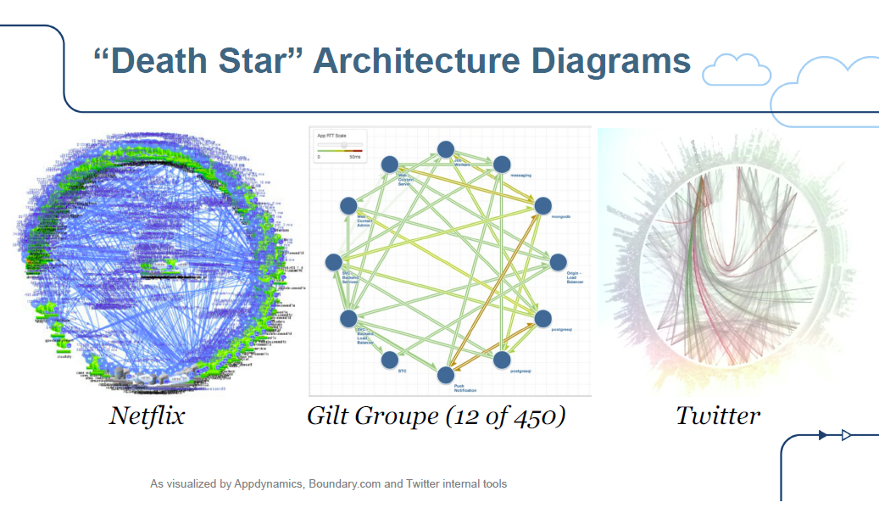
Thing to grok: Apps comprised of microservices can be…
-- Adrian Cockroft (https://github.com/squillace/leap2015/raw/master/gotoberlinpdf-141115183643-conversion-gate02.pdf)

Slide 13
Independence means service code is immutable
Existing services are never changed; new service code deployed as a new service group – nothing changes until routing changes.
A/B, Multiworld, or rolling upgrades
First users are dev/test
Add small random users while measuring
Becomes universally default, with previous service instances running just in case.

Slide 14
Things to grok: edit your microservice specification violently
Everything external to the domain context of the service is a REST call (98% case) to another service for that domain.

Slide 15
Things to grok: know precisely your microservice’s domain
This is, in essence, the ability to understand what you own and what you do not.
*(and stick to it)
NOT. SIMPLE.
Means you might dabble in….

Slide 16
Digression: Domain-driven design: DDD

Slide 17
Things to grok: Don’t order the code
Never tell the team how to build the service from the point of view of another service. Don’t systematize on libraries or code across services.
C++ is great
Python is lovely
Javascript even better
Haskell – sure, why not
We’re big fans of C#...
YOU. DO. NOT. CARE.
If the inputs, outputs, throughput, and failure rates are met, it’s gold. They get power, and the responsibility that comes with it.
But they’ll need your guidance. ☺

Slide 18
Thing to grok: Throw it away, NOW.
If the point of a bunch of services is independence and the ability to survive errors, then when there’s an error, collect what you need and throw it away.
NEVER connect to a service to manually debug. What are you thinking?

Slide 19
Digression: You cannot stop entropy!!
The universe tends to disorder and chaos. Work with it, not against it.
Rental computers break. Software on rented computers has bugs
Thus: Bic diposable services! (Does everyone know Bic? Most famous French company in the United States that no one knows it’s French.)
Designed well, the most you’ll lose is ongoing processing state; perhaps one user might have to retry something… at scale, that’s just fine.
Caveat: stateful services like db services will of course be designed to high-availability and failover in and of themselves, so even they can be torched individually in the worst cases.

Slide 20
Point: if things fail, design for failure
Story: disks fail constantly. In a datacenter, disk are constantly failing. You should expect that each component of your application could hit that disk at any time. Your components should think that’s normal – it’ll happen to them.

Slide 21
Point: Do you wash your rental car?
I didn’t think so….
So, if you’re renting computers, why don’t you burn them up?
RUN YOUR MACHINERY HARD.
Containers
Chaos Monkey
Failure detection
STORAGE strategy: distributed redis into blobs, json blobs (“documents” -- mongodb) and sql backends
Etc.

Slide 22
Point: Do worry that your rental car has a problem, or drop it and get a new one?

Slide 23
Point: Do worry that your rental car has a problem, or drop it and get a new one?
I didn’t think so….
So, if you’re renting computers, why don’t you burn them up?
RUN YOUR MACHINERY HARD.

Slide 24
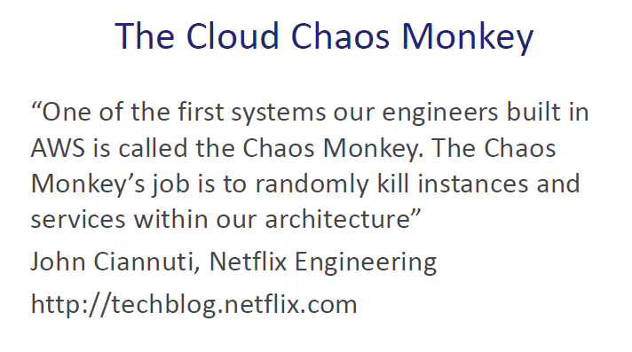
The Chaos Monkey Lives!!!

Slide 25
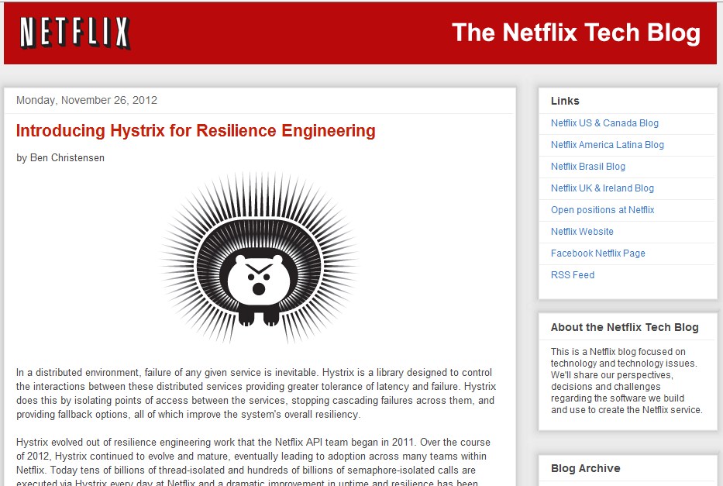

Slide 26

Point: CAP theorem pushes us towards
We must choose between the three; entropy (and wide experience in distributed systems!) teaches us that C(onsistency) is not one of the top two
With one exception: When it is the point of the application. Only then.
-- Adrian Cockroft

Slide 27
Point: Smallest possible partitioned resource
VMs should be smallest
OS should be smallest
Bunches of storages with partition and retry policies
Benefits:
Fine grained scale-out and scale-in
Each failure much smaller portion of entire load
Cost (Duh)

Slide 28
Implications for humans
Ah, execution. Tough stuff.

Slide 29
Implications for humans
Developers think they gain impact; they’re right. They also gain complete responsibility for failure.

Slide 30
Implications for humans
Operations focused on hardware drops massively over the next five years.
Operations focused on developing and managing software compute abstractions increases dramatically.

Slide 31
Implications for humans
Architects focus on everything more and more.
Datacenters are now programs. Programs in datacenters are programs running in programs.

Slide 32
Implications for humans
Because everyone has more focus on apps and infrastructures as apps, that means….
Reorg!!!

Slide 33
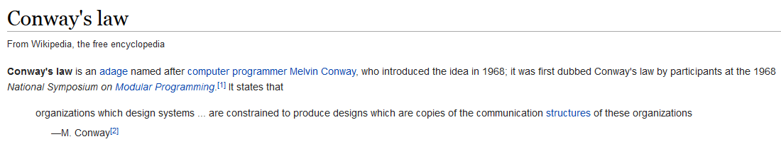
Implications for humans
Use Conway’s law to our advantage
http://en.wikipedia.org/wiki/Conway%27s_law

Slide 34
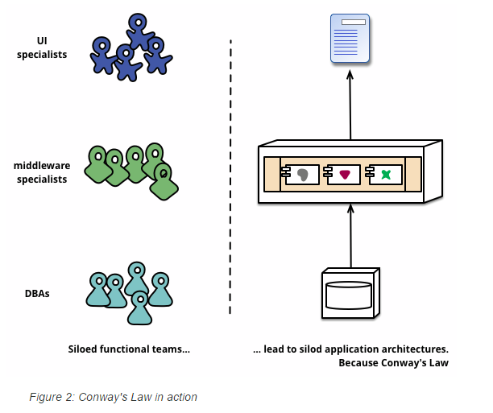
Implications for humans

Slide 35
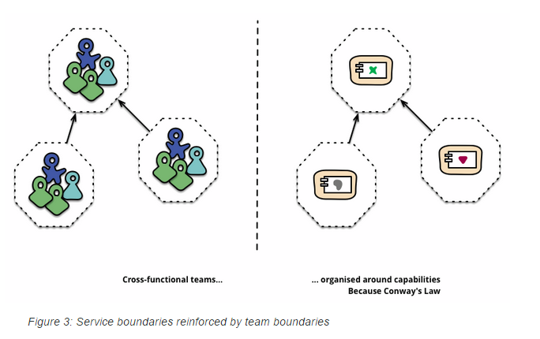
Implications for humans

Slide 36
Thing to grok: any blocking call should be destroyed
Duh. Event driven.

Slide 37
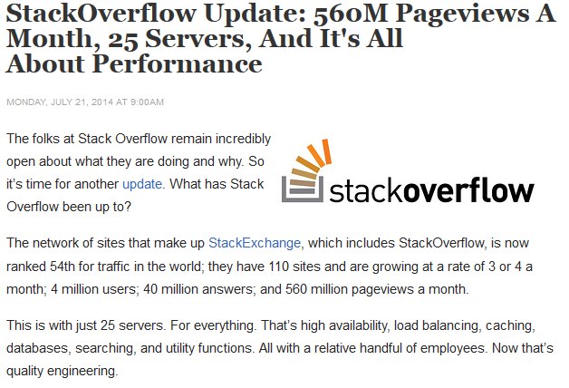
Point: Scale-up works if…
Stackoverflow.com
The exception that proves the rule.
All with SQL Server!
“Stack Overflow still uses Microsoft products. Microsoft infrastructure works and is cheap enough, so there’s no compelling reason to change. Yet SO is pragmatic. They use Linux where it makes sense. There’s no purity push to make everything Linux or keep everything Microsoft. That wouldn’t be efficient.
Stack Overflow still uses a scale-up strategy. No clouds in site. With their SQL Servers loaded with 384 GB of RAM and 2TB of SSD, AWS would cost a fortune. The cloud would also slow them down, making it harder to optimize and troubleshoot system issues. Plus, SO doesn’t need a horizontal scaling strategy. Large peak loads, where scaling out makes sense, hasn’t been a problem because they’ve been quite successful at sizing their system correctly.”

Slide 38
Things to grok: The app is everything at once
Two or more levels of architecture:
Microservices themselves
How all the microservices work together
The infrastructure that makes them happen – that’s all software now

